Slide 1


Devin P.
18.06.2025

Slide 2

Outline
Executive Summary
Introduction
Methodology
Results
Conclusion
Appendix

Slide 3
Executive Summary
Summary of methodologies:
Data Collection through API
Data Collection with Web Scraping
Data Wrangling
Exploratory Data Analysis with SQL
Exploratory Data Analysis with Data Visualization
Interactive Visual Analytics with Folium
Machine Learning Prediction
Summary of all results:
Exploratory Data Analysis results
Interactive analytics in screenshots
Predictive Analytics results

Slide 4
Introduction
SpaceX is the most successful company of the commercial space age, revolutionizing the industry by making space travel significantly more affordable. The company offers Falcon 9 rocket launches for around 62 million dollars, while traditional providers often charge 165 million dollars or more. A key reason for this cost advantage is SpaceX’s ability to reuse the first stage of its rockets by successfully landing them after launch. Reusing rocket stages drastically reduces the cost per launch. Therefore, predicting whether the first stage will land successfully is essential for estimating launch costs. As a data scientist at a startup aiming to compete with SpaceX, the goal of this project is to develop a machine learning pipeline that can predict the landing outcome of the first stage. This insight will be critical for making informed bidding decisions when offering competitive launch services.
Problems:
What factors influence the success of the first stage landing?
How can the success rate of the landing outcome be increased?

Slide 5

Section 1

Slide 6
Methodology
Executive Summary
Data collection methodology:
Collected using web scrapping from Wikipedia and SpaceX REST API
Perform data wrangling
Data processed using one-hot encoding
Perform exploratory data analysis (EDA) using visualization and SQL
Perform interactive visual analytics using Folium and Plotly Dash
Perform predictive analysis using classification models
How to build, tune, evaluate classification models

Slide 7
Data Collection
The Data was collected using API requests from SpaceX REST API and Web Scraping from the SpaceX Wikipedia page.
For the REST API: 1. getting the data via get request 2. normalized the Json to a pandas dataframe 3. Data cleaning and filling missing values.
For the Web Scraping: 1. BeautifulSoup to extract the table on the Wikipedia page 2. Parsed the data and converted it to a pandas dataframe.

Slide 8
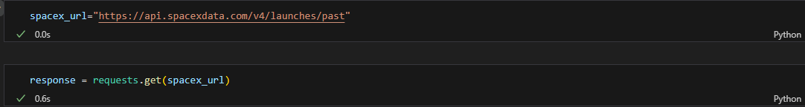
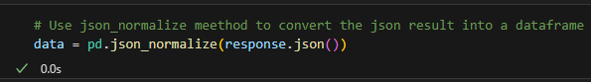
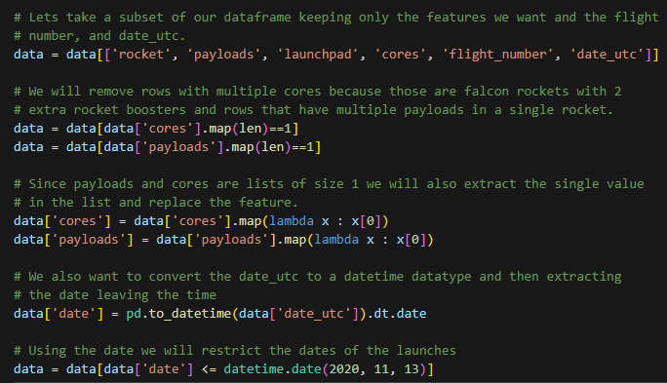
Data Collection – SpaceX API
For rocket launch data: get request using API
Json_normalize to convert json to a dataframe
Datacleaning
Filling missing data values
GitHub: https://github.com/DevinPoppe/IBM-Applied-Data-Science-Capstone/blob/main/jupyter-labs-spacex-data-collection-api-v2.ipynb

Slide 9
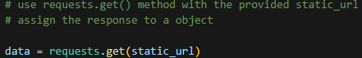
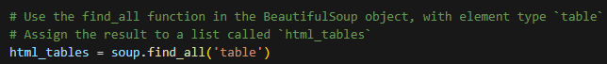
Data Collection - Scraping
Get the data from the URL via requests
Creating a BeautifulSoup object from the response
Find all tables and extract the information
Parse the data
GitHub: https://github.com/DevinPoppe/IBM-Applied-Data-Science-Capstone/blob/main/jupyter-labs-webscraping.ipynb

Slide 10
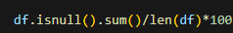
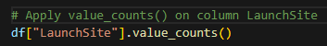
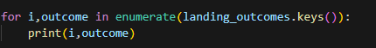
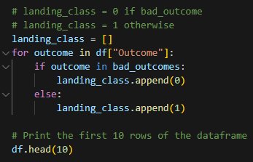
Data Wrangling
1. Data Loading
2. Handling missing values
3. Feature Analysis
4. Outcome Classification
GitHub: https://github.com/DevinPoppe/IBM-Applied-Data-Science-Capstone/blob/main/labs-jupyter-spacex-Data%20wrangling-v2.ipynb

Slide 11
EDA with Data Visualization
1. Flight Number vs. Launch Site
2. Payload Mass vs. Launch Site
3. Success Rate by Orbit Type
4. Flight Number vs. Orbit Type
5. Payload Mass vs. Orbit Type
6. Yearly Success Trend
Scatter plots reveal relationships between numerical and categorical variables. Line plots show yearly trends and bar charts display success rates across different categories.
GitHub: https://github.com/DevinPoppe/IBM-Applied-Data-Science-Capstone/blob/main/jupyter-labs-eda-dataviz-v2.ipynb

Slide 12
EDA with SQL
Performed SQL queries:
Unique Launch Sites
Launch Sites Starting with 'CCA'
Total Payload Mass for NASA (CRS) Missions
Average Payload Mass for Booster F9 v1.1
First Successful Ground Pad Landing Date
Boosters with Drone Ship Success (Payload 4k–6k kg)
Mission Outcomes (Success/Failure Counts)
Mission Outcomes (Success/Failure Counts)
2015 Drone Ship Failures
Landing Outcome Rankings (2010–2017)
Used SQL functions:
DISTINCT, SUM, AVG, MAX, COUNT, LIKE, WHERE, ORDER BY, GROUP BY, strftime
GitHub: https://github.com/DevinPoppe/IBM-Applied-Data-Science-Capstone/blob/main/jupyter-labs-eda-sql-coursera_sqllite.ipynb

Slide 13
Build an Interactive Map with Folium
1. Base Map Elements
Created a Folium Map
2. Launch Site Markers
Added circles around each launch site and displayed their names
3. Launch Outcome Visualization
Grouped markers by location added a color coding to quickly assess success or failure per site
4. Proximity Analysis
To identify positions of nearby infrastructure for logistical advantages (costal sites for easy rocket recovery)
GitHub: https://github.com/DevinPoppe/IBM-Applied-Data-Science-Capstone/blob/main/lab-jupyter-launch-site-location-v2.ipynb

Slide 14
Build a Dashboard with Plotly Dash
Added a success pie chart: to display the success/failure ratio for each launch site. Provides immediate visual comparison
Added a payload vs. success scatter plot: to display the correlation between payload mass and launch success. Helps analyze whether payload mass correlates with mission success and if booster versions perform differently.
The dropdown menu allows for individual selection and the range slider enables filtering payload mass range, which dynamically updates.
GitHub: https://github.com/DevinPoppe/IBM-Applied-Data-Science-Capstone/blob/main/spacex_dash_app.py

Slide 15
Predictive Analysis (Classification)
1. Data Preparation
Standardized the dataset and split data into train/test sets (80/20)
2. Model Selection & Tuning
Tested 4 classification algorithms ( Logistic Regression, SVM, Decision Tree & KNM)
Used GridSearchCV with 10-fold CV for tuning
3. Evaluation
Compared accuracy scores, test set performance
GitHub: https://github.com/DevinPoppe/IBM-Applied-Data-Science-Capstone/blob/main/SpaceX-Machine-Learning-Prediction-Part-5-v1.ipynb

Slide 16
Results
Exploratory data analysis results
Interactive analytics demo in screenshots
Predictive analysis results

Slide 17

Section 2

Slide 18
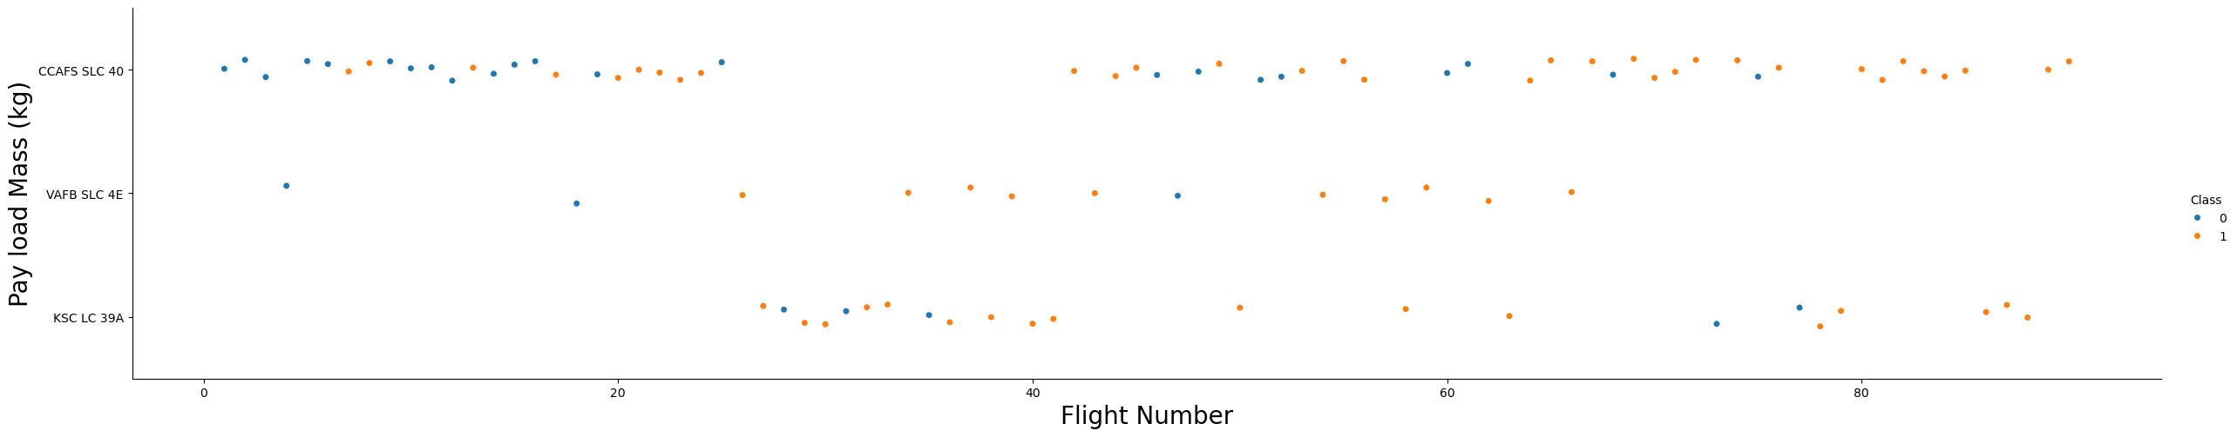
Flight Number vs. Launch Site
As the times goes on more and more flights have a successful outcome
CCAFS SLC 40 has the most amount of all launches, more than 50%
VAFB SLC 4E and KSC LC 39A have a higher success rate than CCAFS SLC 40

Slide 19
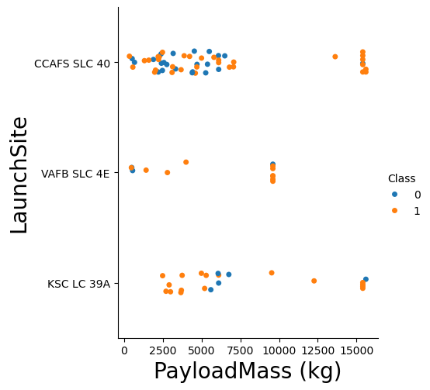
Payload vs. Launch Site
Heavier payloads are launched from CCAFS SLC 40
Most launches are carried out with a payload mass lighter than 7500 kg

Slide 20
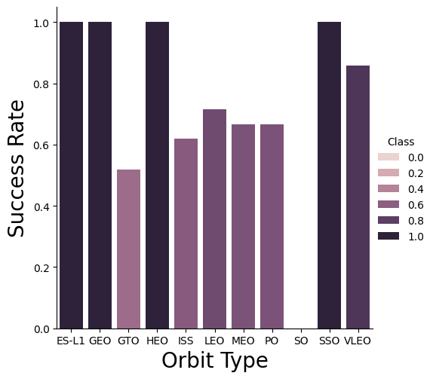
Success Rate vs. Orbit Type
Orbits with 100% success rate: ES-L1, GEO, HEO, SSO
Orbits with success rate between 50% and 85%: GTO, ISS, LEO, MEO, PO
Orbits with 0% success rate: - SO

Slide 21
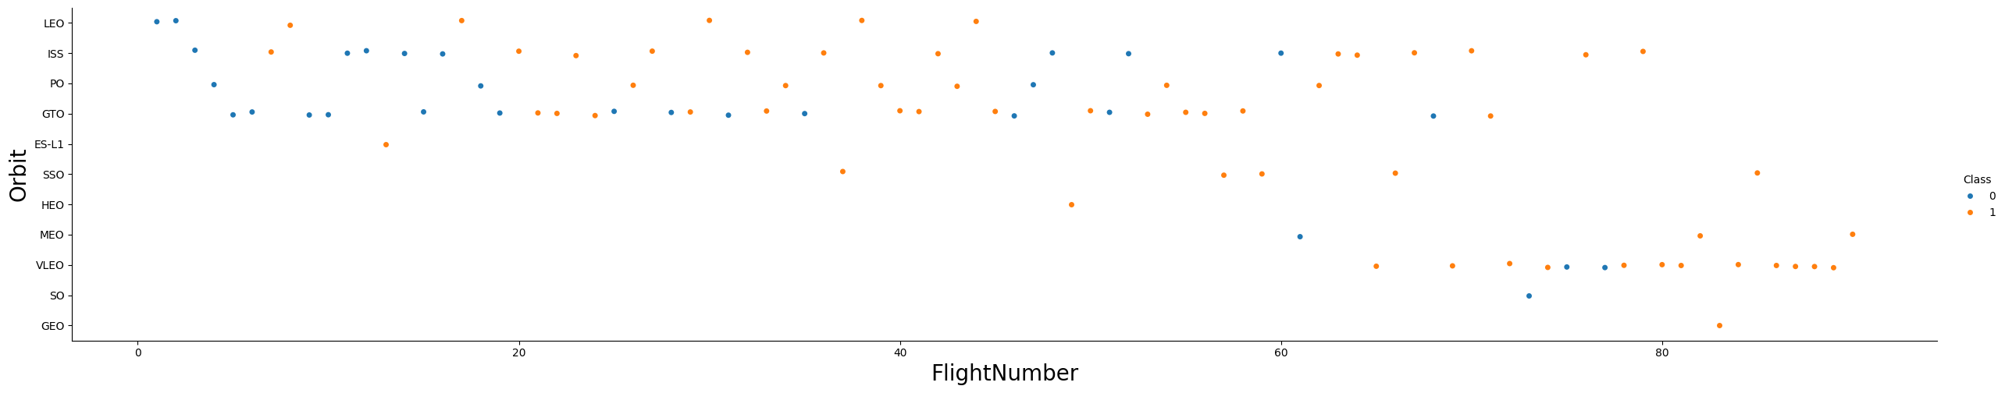
Flight Number vs. Orbit Type
No relationship between flight number and Orbit Type

Slide 22
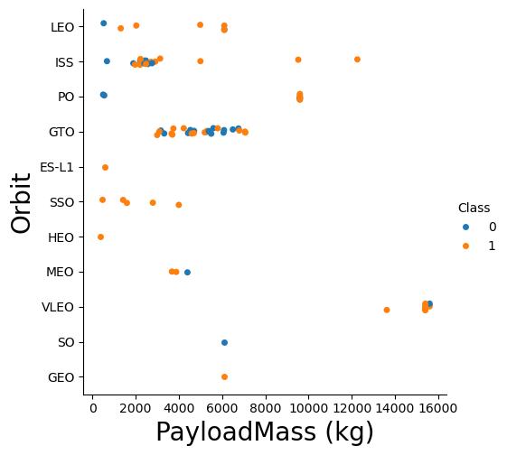
Payload vs. Orbit Type
Heavier payloads tend to negatively influence GTO Orbit launches and positively influence ISS and LEO and PO Orbits.

Slide 23
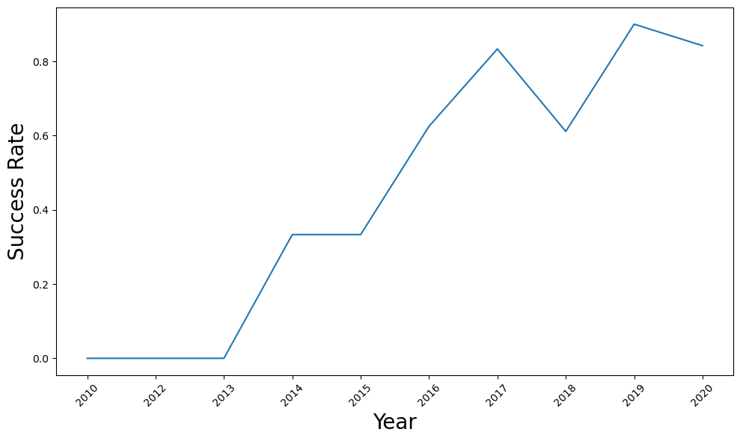
Launch Success Yearly Trend
As the year progresses the success rate increases.

Slide 24
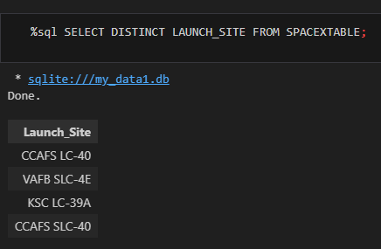
All Launch Site Names
Theses are the unique launch sites from the dataset.

Slide 25
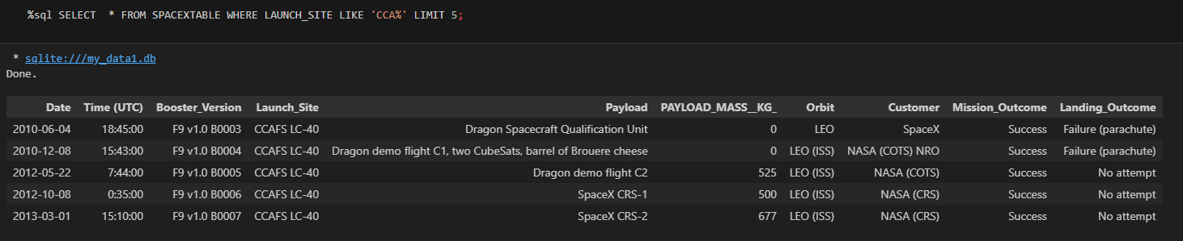
Launch Site Names Begin with 'CCA'
5 records where the launch site begins with “CCA”

Slide 26
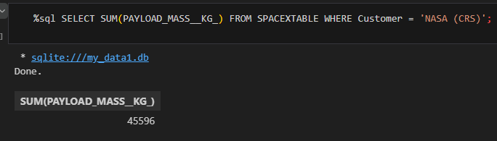
Total Payload Mass
The calculated total payload carried by boosters from NASA is 45596 kg

Slide 27
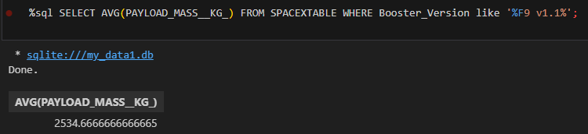
Average Payload Mass by F9 v1.1
Calculate the average payload mass carried by booster version F9 v1.1
Present your query result with a short explanation here
The calculated average payload mass carried by booster version F9 v1.1 is 2534.66 kg

Slide 28
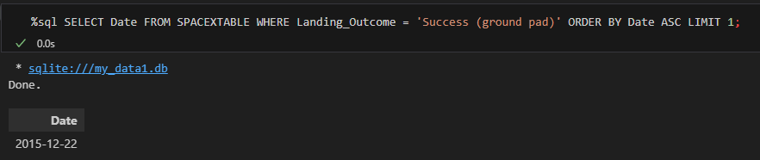
First Successful Ground Landing Date
The first successful ground Landing was 2015-12-22

Slide 29
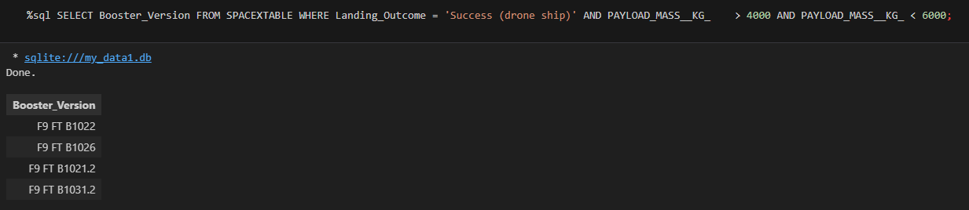
Successful Drone Ship Landing with Payload between 4000 and 6000
The following boosters have successfully landed on drone ships and had payload mass greater than 4000 but less than 6000:

Slide 30
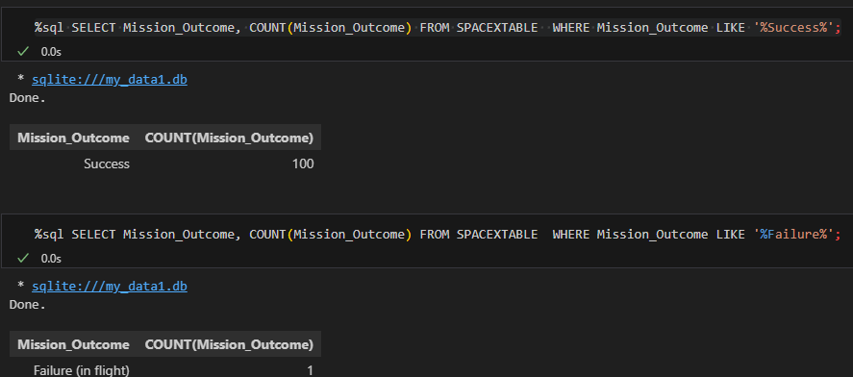
Total Number of Successful and Failure Mission Outcomes
Count function to count the outcomes

Slide 31
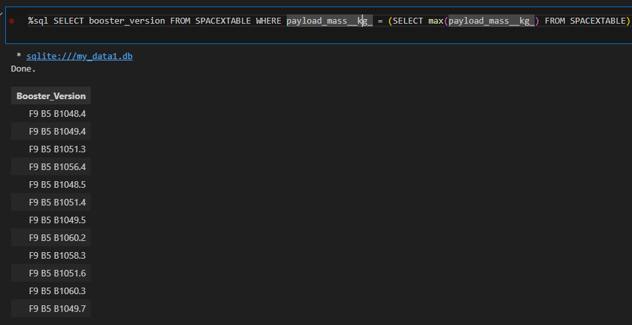
Boosters Carried Maximum Payload
Using a subquery in the Where clause and the max function

Slide 32
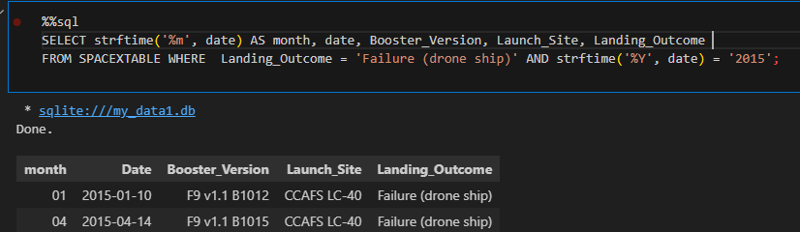
2015 Launch Records
strftime('%m', date) extracts the month from the date column
strftime('%Y', date) extracts the year from the date column

Slide 33
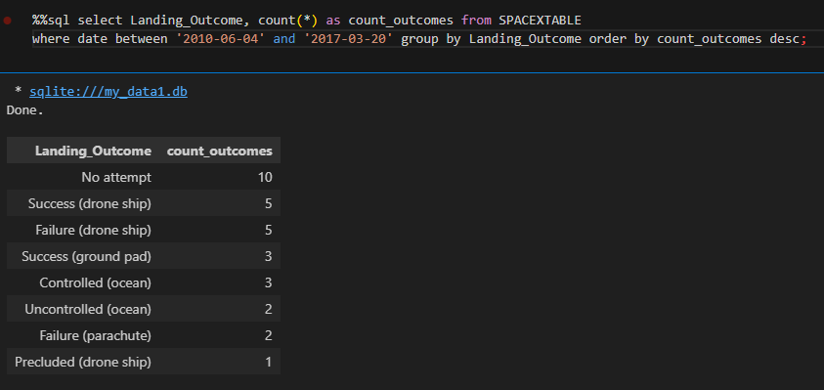
Rank Landing Outcomes Between 2010-06-04 and 2017-03-20
The query groups the results by Landing_Outcome and sorts them by the count in descending order.

Slide 34

Section 3

Slide 35
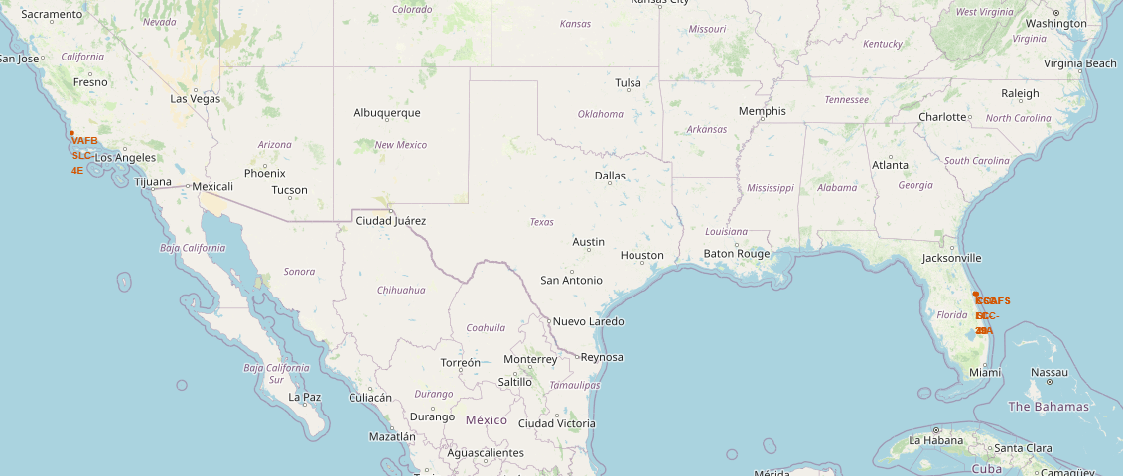
Location of all SpaceX launch sites
They are rather in the south of the US then in the north part of the country.

Slide 36
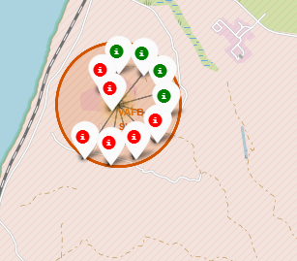
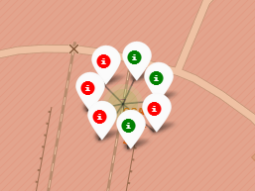
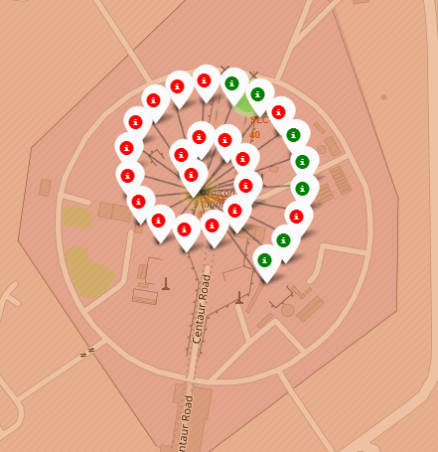
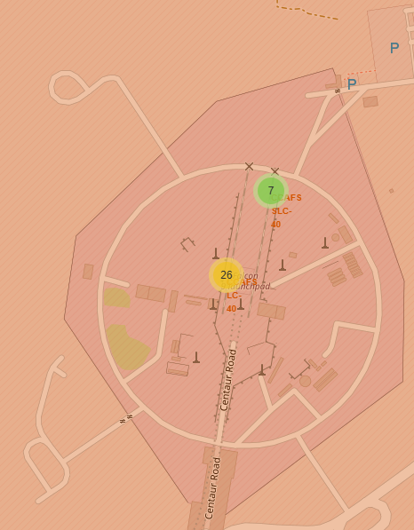
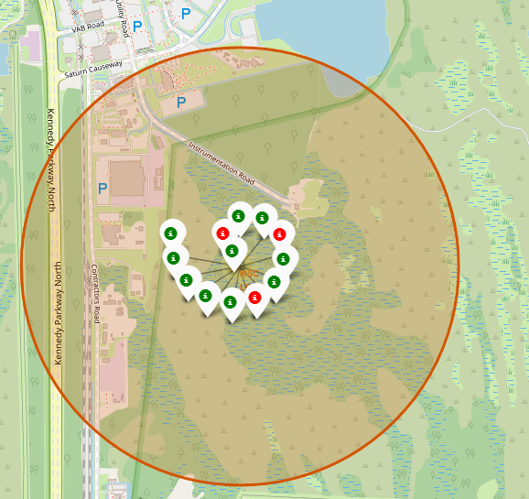
Landing outcomes from the launch sites
The most failed launch outcomes
are in Florida: CCAFS LC-40
Green: Success
Red: Failure

Slide 37
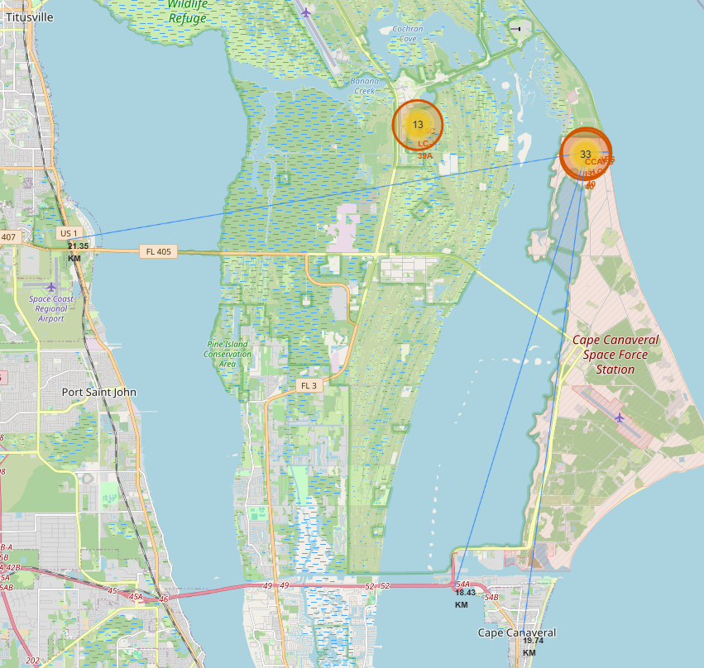
SpaceX Launch Site Proximity
The Distance to the coastline is 1 km.
The Highway is 19 km away.
The nearest city is Cape Canaveral about 19 km away.
A railway-track is 21 km away.

Slide 38

Section 4

Slide 39
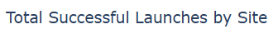
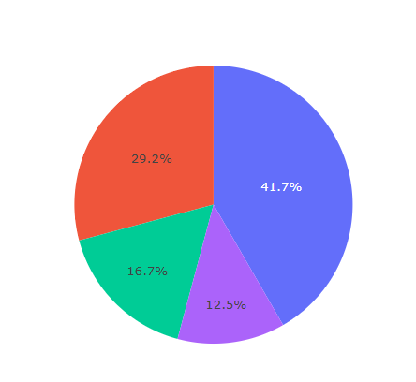
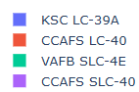
Successful launches by Launch Site
KSC LC-39A has highest rate of success

Slide 40
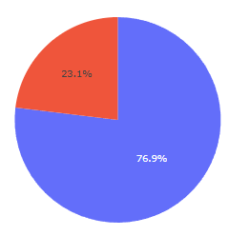
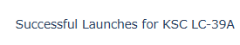
Ratio of successful and failed launches for KSC LC-39A
76.9 % of launches are successful
23.1 % of launches failed

Slide 41
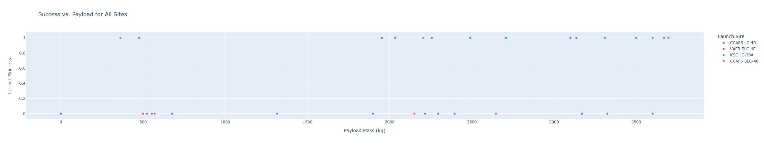
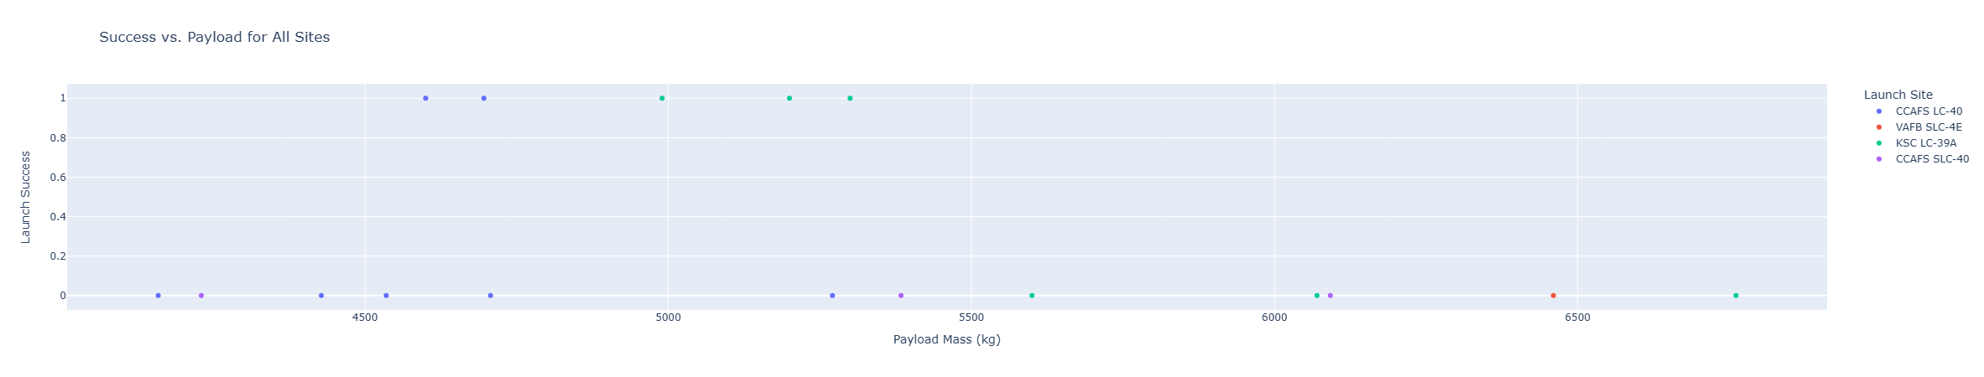
Payload mass against launch outcome
The success rate for lower weighted rockets is higher than heavy weighted rockets.
Payload: 0 – 4000kg
Payload: 4000 – 9000 kg

Slide 42

Section 5

Slide 43
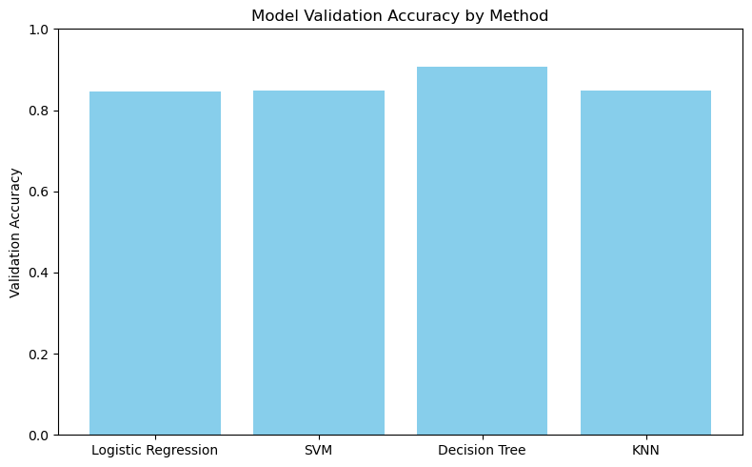
Classification Accuracy
Decision Tree has the highest Model Validation Accuracy.

Slide 44
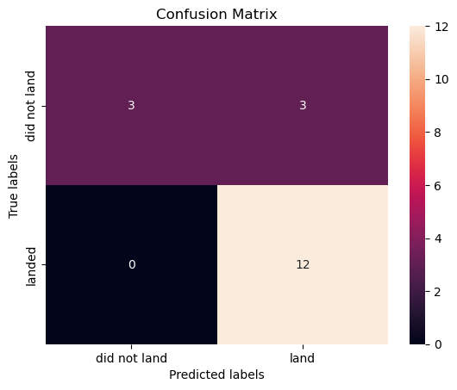
Confusion Matrix
The confusion matrix for the decision tree has the best results.
A major problem with this model are the false positives.

Slide 45
Conclusions
A Decision Tree Model is the best choice for this particular dataset.
Launches with a low payload show better outcomes that launches with a rather higher payload mass.
The success rate increases over the years.
All launch sites are located I proximity to the Equator with close proximity to the sea.
Orbits ES-L1, GEO, HEO and SSO had a 100 % success rate.
KSC LC-39A has highest rate of success of any launch sites.

Slide 46


